Slide 1

ST1504 • DEEP LEARNING CA2
Generative Modelling & Reinforcement Learning
Part A - CIFAR-10 Generation
Part B - Reinforcement Learning
Goal: Generate diverse and plausible
CIFAR-10-like images.
Goal: Train an agent to control
Pendulum-v1 using Deep Q-Learning.
Develop and compare VAE and DCGAN
Apply DQN to Pendulum environment
Select the stronger baseline for further improvement
Convert continuous torque into discrete actions
Improve it systematically
Compare different gravity settings
Generate 1,000 final images
Systematically tune and evaluate the DQN

Slide 2
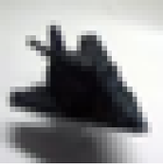
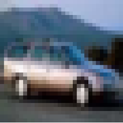
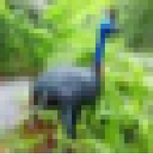
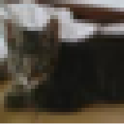
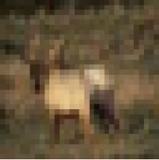
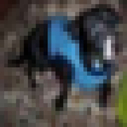
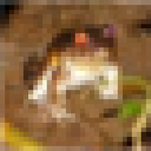
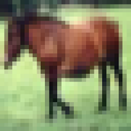

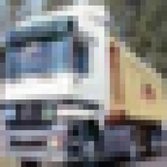
Part A — PROBLEM & DATASET
Dataset
One Training Image from Each CIFAR-10 Class
Controlled split:
45,000 — Training
Model learning
5,000 — Validation
Model comparison & selection
10,000 — Test
Final evaluation only
60,000 RGB images
0: airplane
1: automobile
2: bird
3: cat
4: deer
Image size: 32 × 32 × 3
10 balanced classes
Preprocessing
5: dog
6: frog
7: horse
8: ship
9: truck
CIFAR-10 pixels
0–255 (uint8)
WHY?
Model-specific normalisation matches each model’s output activation and supports stable training.
VAE
DCGAN
Balanced across all 10 classes
float32
[0, 1]
sigmoid output
float32
[-1, 1]
tanh output
No class weighting, oversampling or undersampling required
GOAL
Learn the CIFAR-10 image distribution and generate 1,000 new CIFAR-10-like images.
1

Slide 3
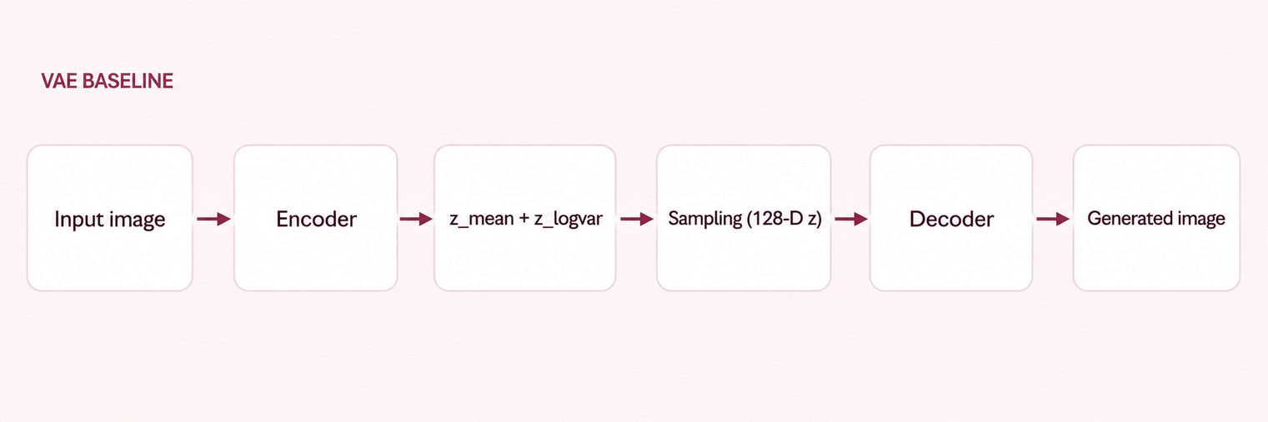
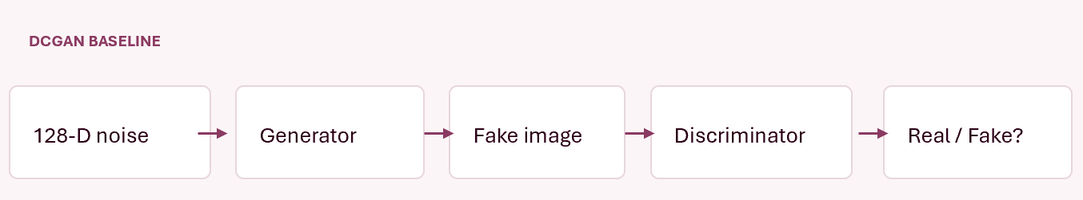
VAE vs DCGAN Baseline Comparison
Controlled Evaluation
  Same number: 1,000 generated images
  Same CIFAR-10 reference set
  Same InceptionV3 feature extractor
  Same evaluation metrics
  Learns a smooth latent distribution and reconstructs images from sampled latent vectors.
Metric | Baseline VAE | Baseline DCGAN
Validation FID | 236.8284 | 96.9811
Average Pairwise MSE | 0.068212 | 0.128495
Key Findings
  DCGAN reduced FID by 59.05% compared with the baseline VAE.
  The VAE produced smoother but more blurred images.
  The DCGAN produced stronger contrast, clearer structure, and more distinct object-like regions.
  Its lower FID indicates a closer match to the real CIFAR-10 feature distribution.
Model Selection Decision
Baseline DCGAN was selected for systematic improvement.

Slide 4
DCGAN Training & Systematic Improvement Strategy
Core DCGAN Training Setup
Four Controlled Improvement Experiments
Setting
Configuration
Training Control
• Images normalised to [-1, 1]
• Data pipeline: Shuffle → Batch → Prefetch
• 1 discriminator update : 1 generator update
• Fixed latent noise for consistent visual monitoring
• Candidate checkpoints evaluated with FID + diversity + visual inspection
Class Conditioning
Training images
45,000
1
  50 epochs
  Support requested-class generation
Latent dimension
128
Longer Training
Batch size
128
2
  Extend budget
  50 → 100 epochs
Baseline epochs
50
Optimiser
Adam
Generator EMA
3
  EMA decay = 0.999
  Smooth generator weights
Learning rate
0.0002
Adam β₁ / β₂
0.5 / 0.999
Alternative Upsampling
4
  Nearest-neighbour upsampling + Conv2D
  Retain accepted settings
Augmentation
None
Key Control principle: Only one main factor was changed at a time; each candidate was compared with its parent using the same evaluation procedure.

Slide 5
Evaluation & Systematic Improvements
How quality was assessed?
Selected Validation FID by Experiment
Primary metric — lower means closer to real CIFAR-10 feature distribution
FID ↓ better
212.16
FID
Average Pairwise MSE
Supporting indicator of output variation
96.98
99.57
83.71
75.27
Visual inspection
Examine structure, colour, repetition and possible collapse.
Baseline
Cond.
100 ep.
EMA
Upsampling
1 . Class Conditioning
2 . Longer Training
3. Generator EMA
4. Alternative Upsampling
FID 99.57
FID 83.71
FID 75.27
FID 212.16
Rejected for quality; retained for class control
Accepted
Accepted + final quality model
Rejected
FID Sample-Size Sensitivity
Same final generator — no retraining
  1,000 samples: FID = 74.97
  5,000 samples: FID = 40.13
  Lower FID at 5,000 samples reflects sample-size sensitivity, not model improvement.
  Therefore, FID was only compared under the same sample size and evaluation protocol.
Final Model — Epoch 100 EMA DCGAN
  Validation FID: 75.27
  Post-selection test FID: 74.97
  22.39% FID reduction from baseline to final model

Slide 6
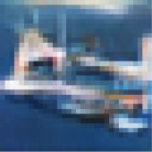
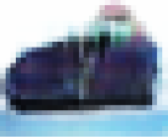
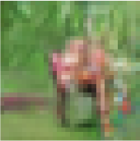
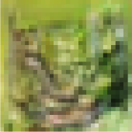
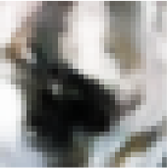

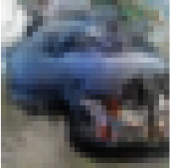
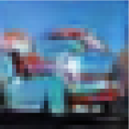
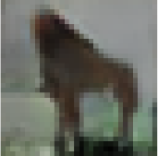
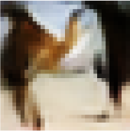
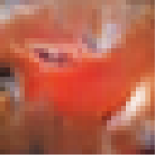
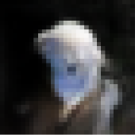
Final EMA DCGAN Generated Image Results
Stronger Examples
Marginal Examples
Poor Examples
Clearer foreground-background separation and more recognisable object-like structure
Plausible global structure, but semantic identity remains ambiguous
Blurred, distorted or poorly defined object structure
Overall Qualitative Result
  Final EMA samples show varied colour, foreground shape, object position and background composition.
  Many samples contain clearer object-like regions and foreground–background separation.
  Some outputs remain blurred or semantically ambiguous, with fine detail limited at 32 × 32.
  No obvious visual evidence of severe output repetition.

Slide 7

THANK YOU
www.reallygreatsite.com

